Slide 1
The Definition of Epilepsy
Robert S. Fisher, MD, PhD
Maslah Saul MD Professor of Neurology
Director, Stanford Epilepsy Center
In 2005, the ILAE released a conceptual definition of seizures and epilepsy, followed by an operational (practical) definition in 2014. The key changes were: epilepsy can exist after two unprovoked seizures more than 24 hours apart (the old definition) or one unprovoked seizure when the risk for another is known to be high (>60%); reflex seizures and seizures that are part of an epilepsy syndrome constitute epilepsy; epilepsy may be considered resolved when an age-dependent syndrome is outgrown or when a person is seizure-free for at least 10 years, the last 5 off anti-seizure medicines.
The attached PowerPoint slide set may be used without need to request permission for any non-commercial educational purpose meeting the usual "fair use" requirements. Permission from robert.fisher@stanford.edu is however required to use any of the slides in a publication or for commercial use. When using the slides, please attribute them to Fisher et al. ILAE official report: a practical clinical definition of epilepsy. Epilepsia, 2014; 55:475-82.

Slide 2

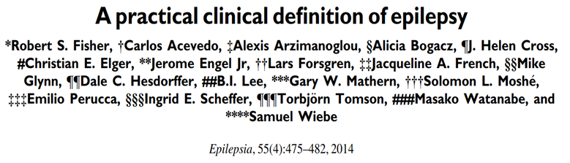
ILAE OFFICIAL REPORT
Epilepsy is a disease of the brain defined by any of the following conditions
1. A least two unprovoked (or reflex) seizures occurring >24 h apart
2. One unprovoked (or reflex) seizure and a probability of further seizures similar to
the general recurrence risk (at least 60%) after two unprovoked seizures, occurring
over the next 10 years
3. Diagnosis of an epilepsy syndrome
Epilepsy is considered to be resolved for individuals who had an age-dependent epilepsy syndrome but are now past the applicable age or those who have remained seizure-free for the last 10 years, with no seizure medicines for the last 5 years.

Slide 3
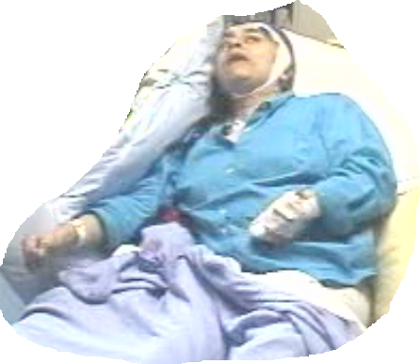
Seizure versus Epilepsy
A seizure is the event
Epilepsy is the disease associated
with spontaneously recurring
seizures

Slide 4
Conceptual Definition of Epilepsy
Epilepsia, 46(4):470-472, 2005
Blackwell Publishing, Inc. © 2005 International League Against Epilepsy
Epileptic Seizures and Epilepsy: Definitions Proposed By the International League Against Epilepsy (ILAE) and the International Bureau for Epilepsy (IBE).
Fisher RS, van Emde Boas W, Blume W, Elger C, Genton P, Lee P, Engel J Jr.
Epilepsy is a disorder of the brain characterized by an enduring predisposition to generate epileptic seizures, and by the neurobiologic, cognitive, psychological, and social consequences of this condition. The definition of epilepsy requires the occurrence of at least one epileptic seizure.

Slide 5
Traditional Epilepsy Definition
Epilepsy is a disorder characterized by two or more unprovoked seizures
occurring more than 24 hours apart.
Concise, easy to apply, known to many, but . . .
Some people now are treated as if they have epilepsy after 1 seizure
A person can never outgrow epilepsy
Can have an epilepsy syndrome (e.g., BRE), but not epilepsy
Those with photic or reflex seizures are not defined as having epilepsy

Slide 6
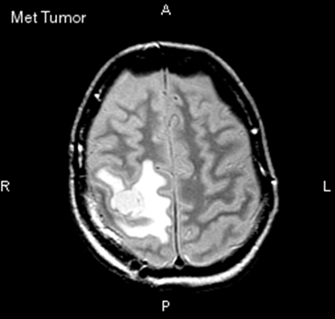
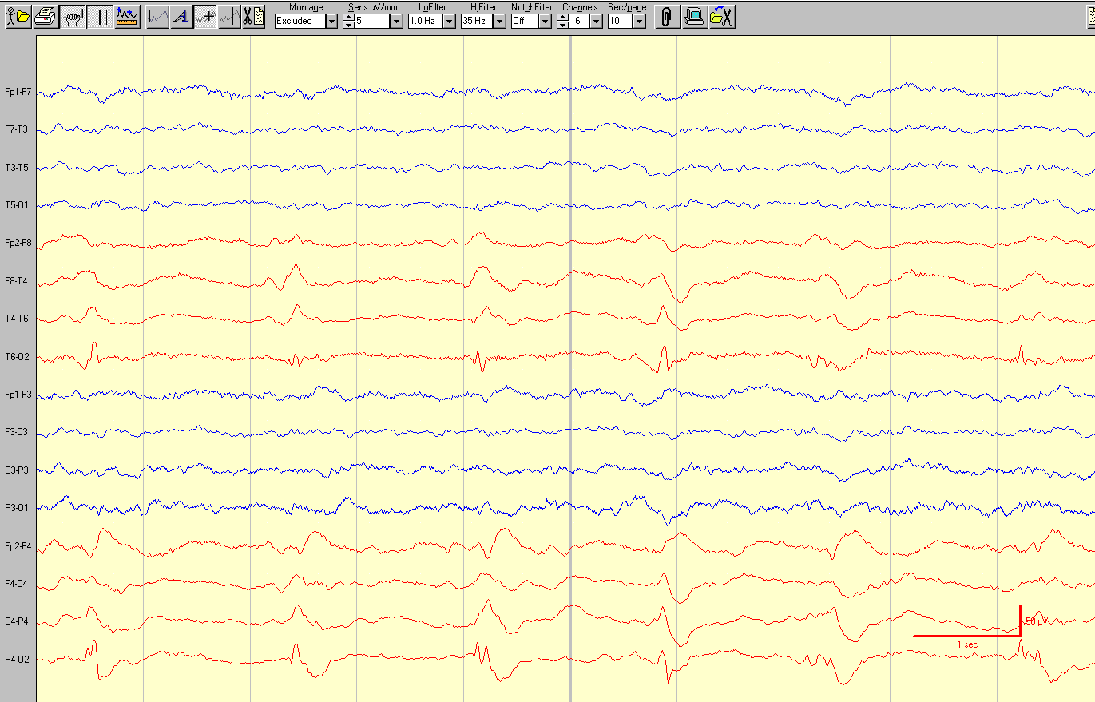
Some people now are treated as if they have epilepsy after 1 seizure

Slide 7
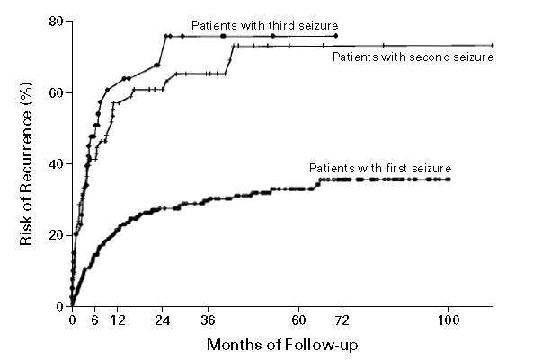
Risk of epilepsy after 2 seizures
After two unprovoked seizures, the risk of a 3rd by 60 months is 73% (59-87%, 95% confidence intervals.
So adopt 59 (~ 60%) as the lower end of the confidence interval for the recurrence risk we all agree is epilepsy.
Hauser et al. Risk of recurrent seizures after two
unprovoked seizures. NEJM 1998;338:429.

Slide 8
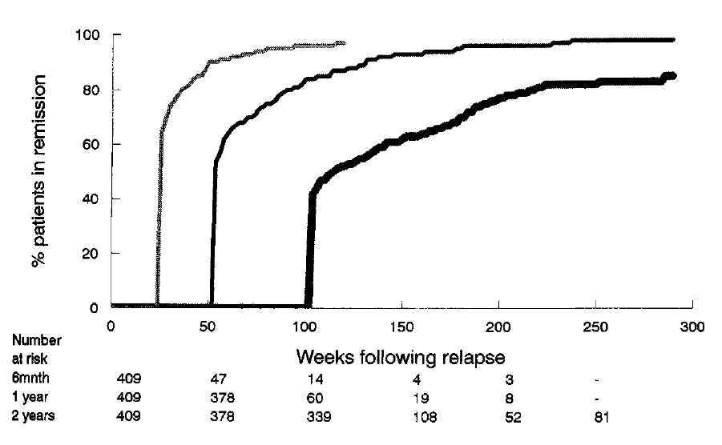
Can a person outgrow epilepsy ?
If seizure-free for a few years,
Then relapse risk is relatively low.
Chadwick D, Taylor J, Johnson T. Outcomes after seizure recurrence in people with well-controlled epilepsy and the factors that influence it. The MRC Antiepileptic Drug Withdrawal Group. Epilepsia. 1996;37:1043-50.

Slide 9
Epilepsy Resolved
Epilepsy is now considered to be resolved* for individuals who had an age-dependent epilepsy syndrome but are now past the applicable age or those who have remained seizure-free for the last 10 years, with no seizure medicines for the last 5 years.
*
Avoiding preconceptions associated with the words “cure” and “remission.”
“Resolved” has the connotation of “no longer present,” but it does not guarantee that epilepsy will never come back
Fisher et al, Epilepsia 55 (4): 475-482, 2014

Slide 10
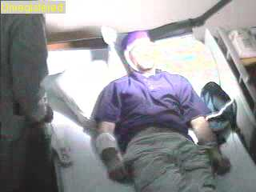
Reflex Epilepsies
Despite the fact that seizures are “provoked” in reflex epilepsies, these are considered epilepsy, because…
If the seizure threshold were not altered, these precipitants would typically not cause seizures
  e.g., photosensitive epilepsy, eating epilepsy

Slide 11
“The revised definition places no burden on the treating physician to specify recurrence risk in a particular circumstance.
In the absence of clear information about recurrence risk, or even knowledge of such information, the default definition of epilepsy originates at the second unprovoked seizure.
On the other hand, if information is available to indicate that risk for a second seizure exceeds that which is usually considered to be epilepsy (about 60%), then epilepsy can be considered to be present”
Fisher et al, Epilepsia 55 (4): 475-482, 2014

Slide 12
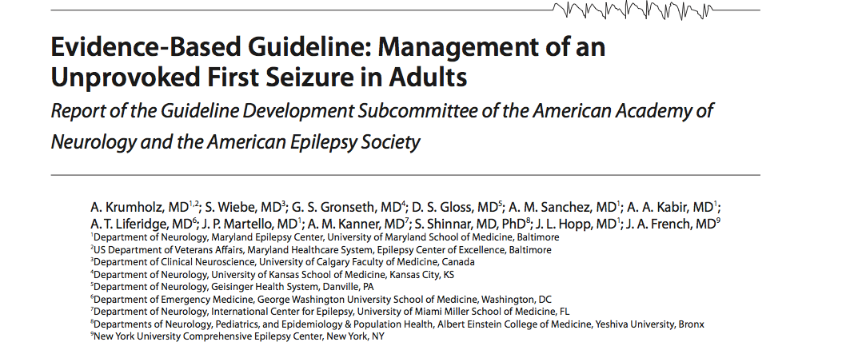
Courtesy of Jacqueline French

Slide 13
AAN Guideline
Conclusion:
Adults with an unprovoked first seizure should be informed that sz recurrence risk is greatest early within the first 2 years (21%–45%) (Level A), and clinical variables associated with increased risk may include:
  a prior brain insult (Level A),
  an epileptiform EEG (Level A),
  an abnormal CT/MRI(Level B)
  a nocturnal seizure (Level B).
Courtesy of Jacqueline French

Slide 14
AAN Guideline
Immediate antiepileptic drug (AED) therapy, as compared with delay of treatment pending a second seizure, is likely to reduce recurrence risk within the first 2 years (Level B)
Clinicians’ recommendations whether to initiate immediate AED treatment after a first seizure should be based on individualized assessments that weigh the risk of recurrence against the adverse events of AED therapy.
Courtesy of Jacqueline French

Slide 15
These are not Epilepsy because there is small risk of a seizure in the absence of a precipitating factor
    Febrile seizures in children age 0.5 – 6 years old
    Alcohol-withdrawal seizures
    Metabolic seizures (sodium, calcium, magnesium, glucose, oxygen)
    Toxic seizures (drug reactions or withdrawal, renal failure)
    Convulsive syncope
    Acute concussive convulsion
    Seizures within first week after brain trauma, infection or stroke

Slide 16
ILAE Definition of Acute Symptomatic Epilepsy
Acute symptomatic seizures are events, occurring in close temporal relationship with an acute CNS insult, which may be metabolic, toxic, structural, infectious, or due to inflammation. The interval between the insult and seizure may vary due to the underlying clinical condition.
Acute symptomatic seizures have also been called:
  Reactive seizures
  Provoked seizures
  Situation-related seizures
Beghi et al. Epilepsia 2010;51:671-675
Courtesy of Dale Hesdorffer

Slide 17
Defining time in acute symptomatic seizures
Events within 1 week of:
  Stroke
  TBI
  Anoxic encephalopathy
  Intracranial surgery
  First identification of subdural hematoma
  Presence of an active CNS infection
  During an active phase of multiple sclerosis or other autoimmune disease
Beghi et al. Epilepsia 2010;51:671-675
Courtesy of Dale Hesdorffer

Slide 18
Acute symptomatic afebrile seizures: Incidence, proportion and recurrence
Age-adjusted incidence of acute symptomatic seizures was 39/100,000 in Rochester, MN
The acute symptomatic seizure incidence was 29/100,000 in Gironde France
These both represented 40% of all afebrile seizures in the community
Recurrent seizures
Acute symptomatic seizures are unlikely to be recurrent
Unprovoked seizures are often recurrent
Annegers et al. Epilepsia 1995;36:327-333; Loiseau et al. These, 1987.
Courtesy of Dale Hesdorffer

Slide 19
Cumulative risk for recurrent unprovoked seizure, Rochester 1955-84: Structural Etiologies: CNS infection, stroke, TBI
More than 1 week after injury
Univariate RR=0.2, 95% CI=0.1-0.3
Adjusted RR=0.02 (95% CI=0.2-0.4), adjusting for age gender and SE
Hesdorffer et al. Epilepsia 2009
Courtesy of Dale Hesdorffer

Slide 20
HYPOTHETICAL CASE: Two seizures
A 25 year-old woman has two unprovoked seizures one year apart.

Slide 21
HYPOTHETICAL CASE: Two seizures
A 25 year-old woman has two unprovoked seizures one year apart.
Comment: This person has epilepsy, according to both the old and new definitions.

Slide 22
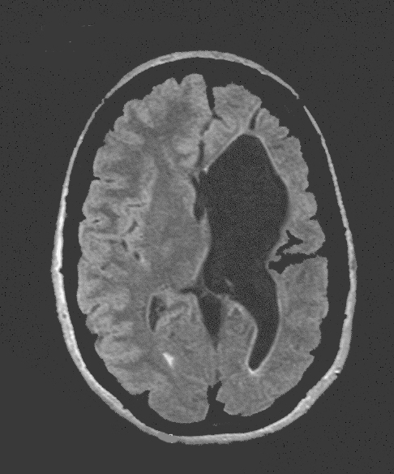
HYPOTHETICAL CASE: Stroke & Seizure
A 65 year-old man had a left middle cerebral artery stroke 6 weeks ago and now presented with an unprovoked seizure.

Slide 23
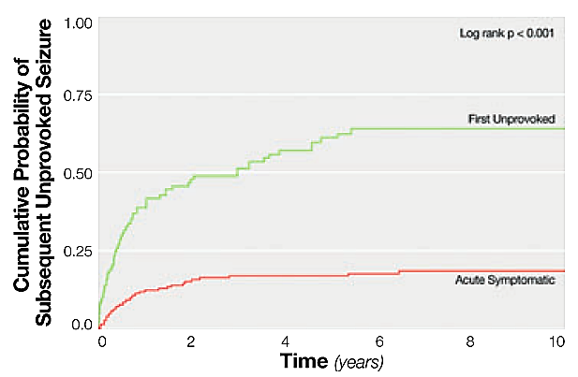
HYPOTHETICAL CASE: Stroke & Seizure
A 65 year-old man had a left middle cerebral artery stroke 6 weeks ago and now presented with an unprovoked seizure.
Comment: With a seizure in this time relation to a stroke (or brain infection or brain trauma) the literature (Hesdorffer et al., 2009) suggests a high (> 70%) risk of another unprovoked seizure. Therefore, in the new (but not the old) definition, this man would have epilepsy.

Slide 24
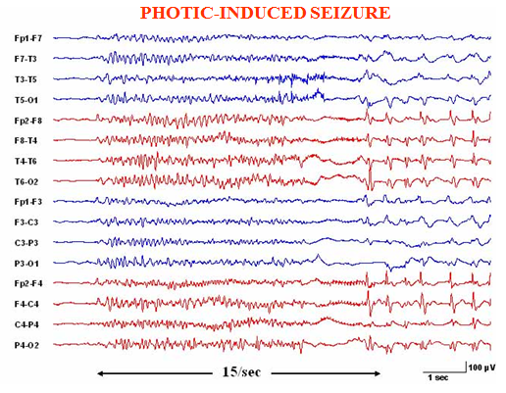
HYPOTHETICAL CASE: Photic Seizure
A 6 year-old boy has had 2 seizures 3 days apart while playing a videogame involving flashing lights. There have been no other seizures. EEG shows an abnormal photoparoxysmal response.

Slide 25
HYPOTHETICAL CASE: Photic Seizure
A 6 year-old boy has had 2 seizures 3 days apart while playing a videogame involving flashing lights. There have been no other seizures. EEG shows an abnormal photoparoxysmal response.
Comment: This boy has epilepsy according to the new definition (but not the old), even though the seizures are provoked by lights, since there is an abnormal enduring predisposition to have seizures with light flashes.

Slide 26
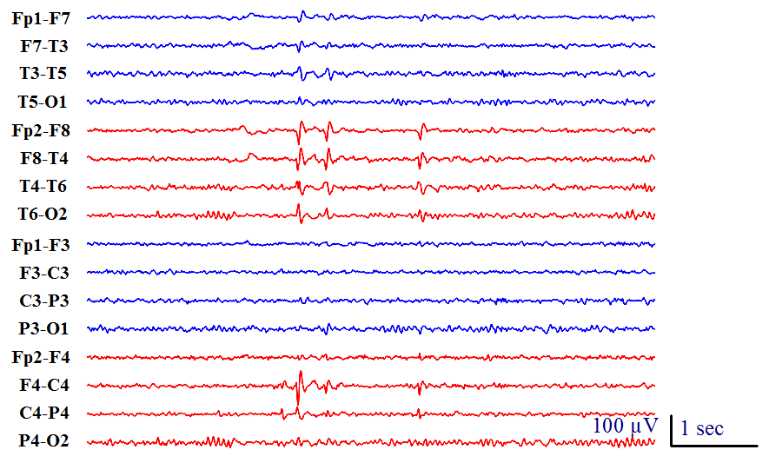
Benign Epilepsy with Centro-Temporal Spikes (BECTS)
A 25 year-old man had seizures with face twitching when falling asleep at ages 9, 10 and 11 years; none since. EEG at age 9 years demonstrated centro-temporal spikes.

Slide 27
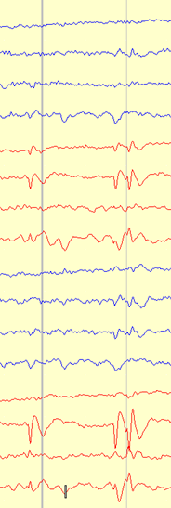
Benign Epilepsy with Centro-Temporal Spikes (BECTS)
A 25 year-old man had seizures with face twitching when falling asleep at ages 9, 10 and 11 years; none since. EEG at age 9 years demonstrated centro-temporal spikes.
Comment: For this young man, epilepsy is no longer present, because of passing the relevant age range of an age-dependent syndrome. The old definition has no provision for considering epilepsy to be no longer present.

Slide 28
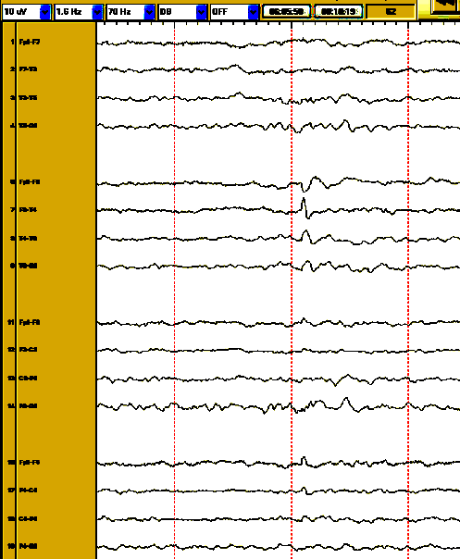
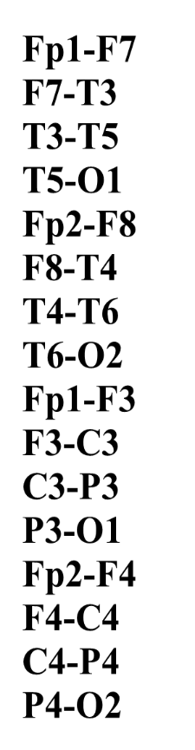
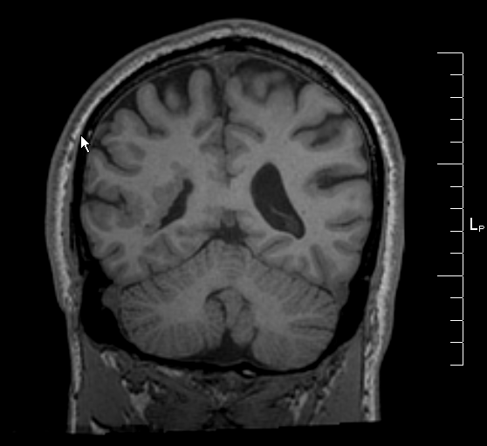
HYPOTHETICAL CASE: Single Seizure & Dysplasia
A 40 year-old man had a focal seizure characterized by left hand twitching that progressed to a tonic-clonic seizure. This was his only seizure. MRI shows a probable periventricular dysplasia in the right frontal lobe and EEG shows right fronto-temporal interictal spikes.
dysplasia

Slide 29
HYPOTHETICAL CASE: Single Seizure & Dysplasia
A 40 year-old man had a focal seizure characterized by left hand twitching that progressed to a tonic-clonic seizure. This was his only seizure. MRI shows a probable periventricular dysplasia in the right frontal lobe and EEG shows right fronto-temporal interictal spikes.
Comment: Although many clinicians would reasonably treat this man with anti-seizure medications, the recurrence risk for seizures is not precisely known, and therefore epilepsy cannot yet be said to be present according to either definition. Should evidence later indicate at least a 60% risk for another seizure, then a diagnosis of epilepsy would be justified by the new definition.

Slide 30


HYPOTHETICAL CASE: Two Seizures Long Ago
An 85 year-old man had a focal seizure at age 6 and another at age 8 years. EEG, MRI, blood tests and family history were all unrevealing. He received anti-seizure drugs from age 8 to age 10 years, when they were discontinued. There have been no further seizures.

Slide 31
HYPOTHETICAL CASE: Two Seizures Long Ago
An 85 year-old man had a focal seizure at age 6 and another at age 8 years. EEG, MRI, blood tests and family history were all unrevealing. He received anti-seizure drugs from age 8 to age 10 years, when they were discontinued. There have been no further seizures.
Comment: According to the new definition, epilepsy is no longer present, since he has been more than 10 years seizure-free and off seizure medication. This is not a guarantee against future seizures, but he has a right to be viewed as someone who does not currently have epilepsy.

Slide 32
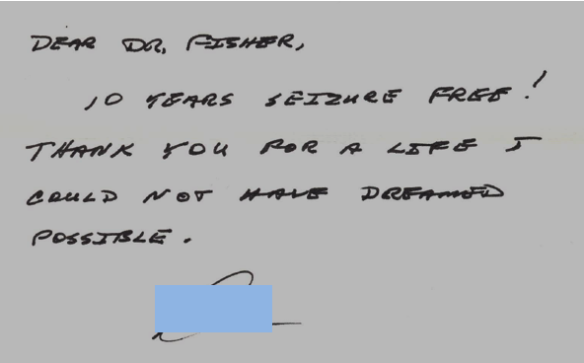
This patient is now flying private aircraft

Slide 33
HYPOTHETICAL CASE: Long-Interval Seizures
A 70 year-old woman had unprovoked seizures at ages 15 and 70. EEG, MRI and family history are unremarkable.
Age 15 70

Slide 34
HYPOTHETICAL CASE: Long-Interval Seizures
A 70 year-old woman had unprovoked seizures at ages 15 and 70. EEG, MRI and family history are unremarkable.
Comment: Both old and new definitions consider this woman to have epilepsy. Despite the diagnosis, many clinicians would not treat because of the infrequency of seizures. Should investigations somehow show that the causes of the two seizures were different, then epilepsy would not be considered to be present.

Slide 35

HYPOTHETICAL CASE: Questionable Information
A 20 year-old man has had 3 unobserved episodes over 6 months consisting of sudden fear, difficulty talking and a need to walk around. He is not aware of any memory loss during the episodes. There are no other symptoms. He has no risk factors for epilepsy and no prior known seizures.

Slide 36
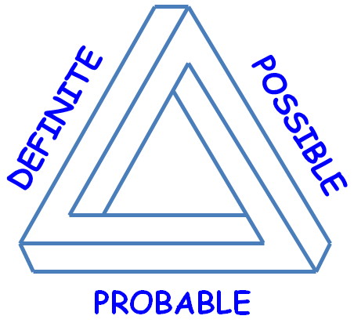
HYPOTHETICAL CASE: Questionable Information
A 20 year-old man has had 3 unobserved episodes over 6 months consisting of sudden fear, difficulty talking and a need to walk around. He is not aware of any memory loss during the episodes. There are no other symptoms. He has no risk factors for epilepsy and no prior known seizures.
Comment: Declaring this man to have epilepsy is impossible by either the old or new definition. Focal seizures are on the differential diagnosis of his episodes, but both definitions of epilepsy require confidence that the person has had at least one seizure, rather than one of the imitators of seizures. Future discussions may define the boundaries of “possible and probable epilepsy.”

Slide 37
New
definition
No longer
present
How
Big ?
Old definition

Slide 38


Possible Consequences
Good
Closer to clinician view
Helps reimbursement
Support for earlier diagnosis
Encourages disease-modifying therapy
Allows for epilepsy no longer present
Not so Good
May upset those diagnosed sooner
May increase stigma for some
Label of epilepsy may restrict some activities
Data on seizure recurrence is limited
Makes diagnosis more complex

